Slide 1

Data Science Education Analysis
MIE1624 Group 9

Slide 2

Agenda
Data Science Education Current State
Data Science and A.I. Program Design for University of Toronto
EdTech solution for Professional Development

Slide 3

Current State of Data Science Education
What is the issue?
Increasing demand of data professionals;
What is our proposal?
A new Master program curriculum for University of Toronto;
A personalized career coaching system
Identify gaps in technical skills
Recommend corresponding online courses
Disconnect between academic program and real word data science application

Slide 4
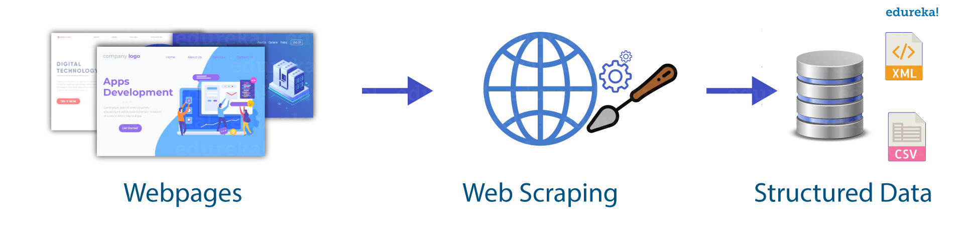


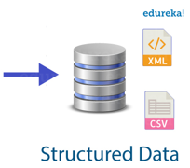



Data Collection
Kaggle
Machine Learning & Data Science Survey

Slide 5
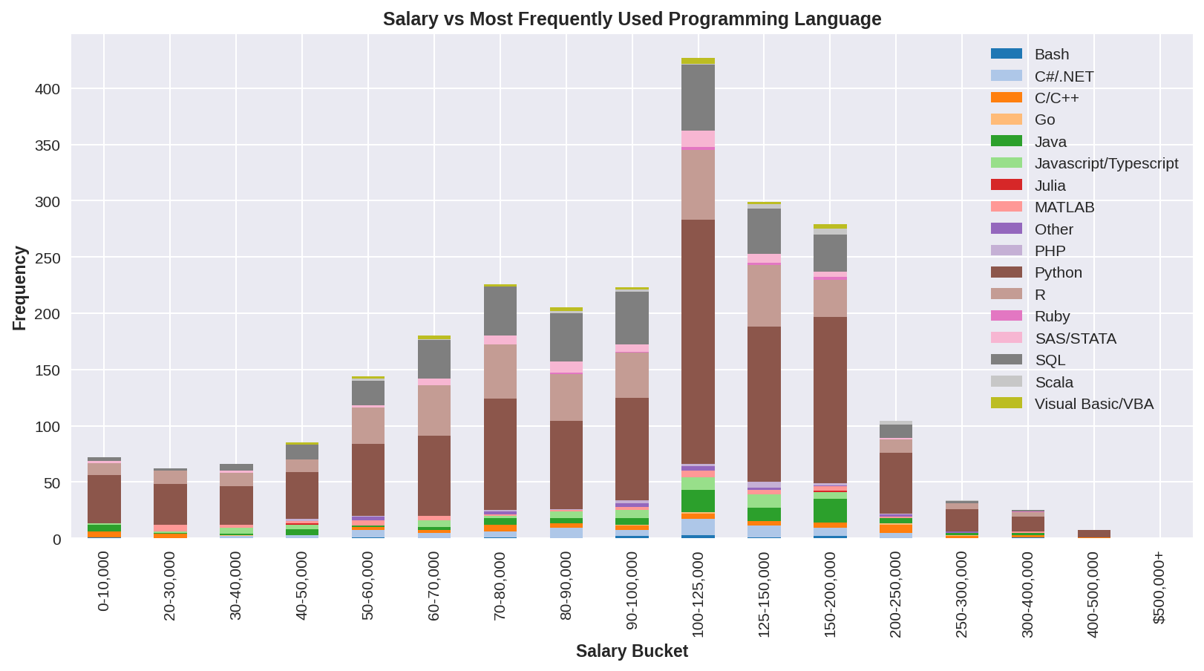
Data Analysis Examples – Kaggle Survey

Slide 6
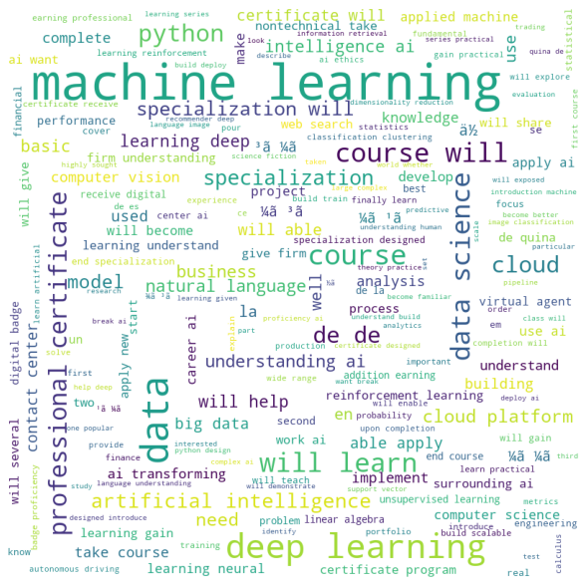
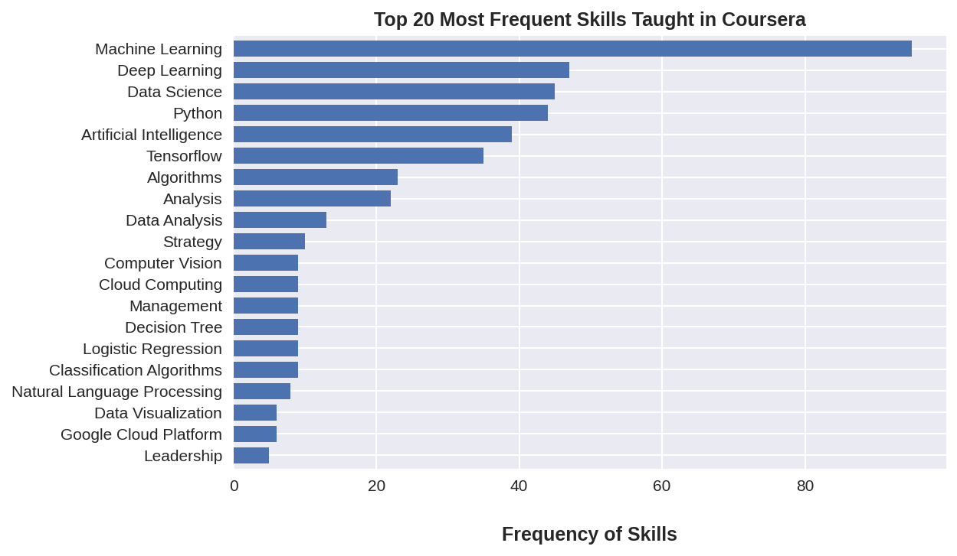
Data Analysis Examples – Coursera

Slide 7
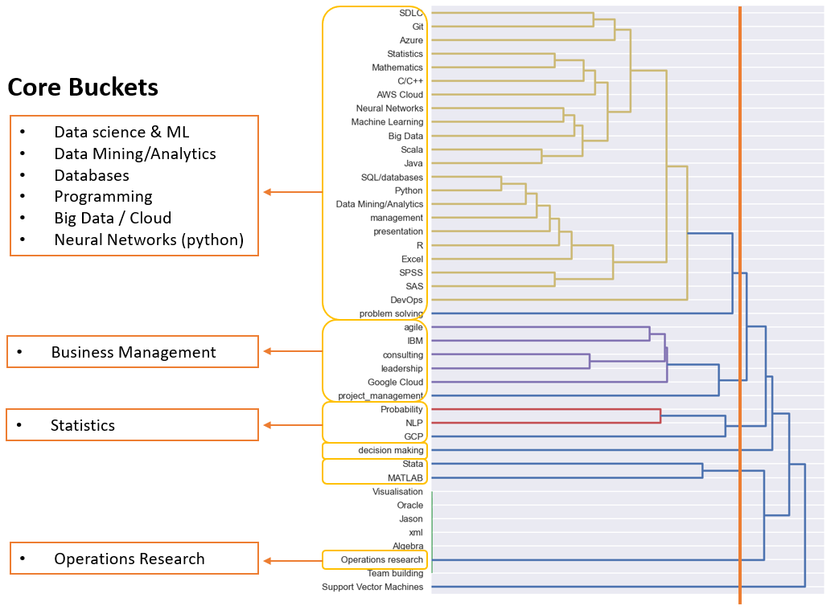
Program Curriculum
The foundation of the program curriculum was built based on Kaggle Survey
Hierarchical Clustering
→ 4 Core Buckets of Skill Sets

Slide 8
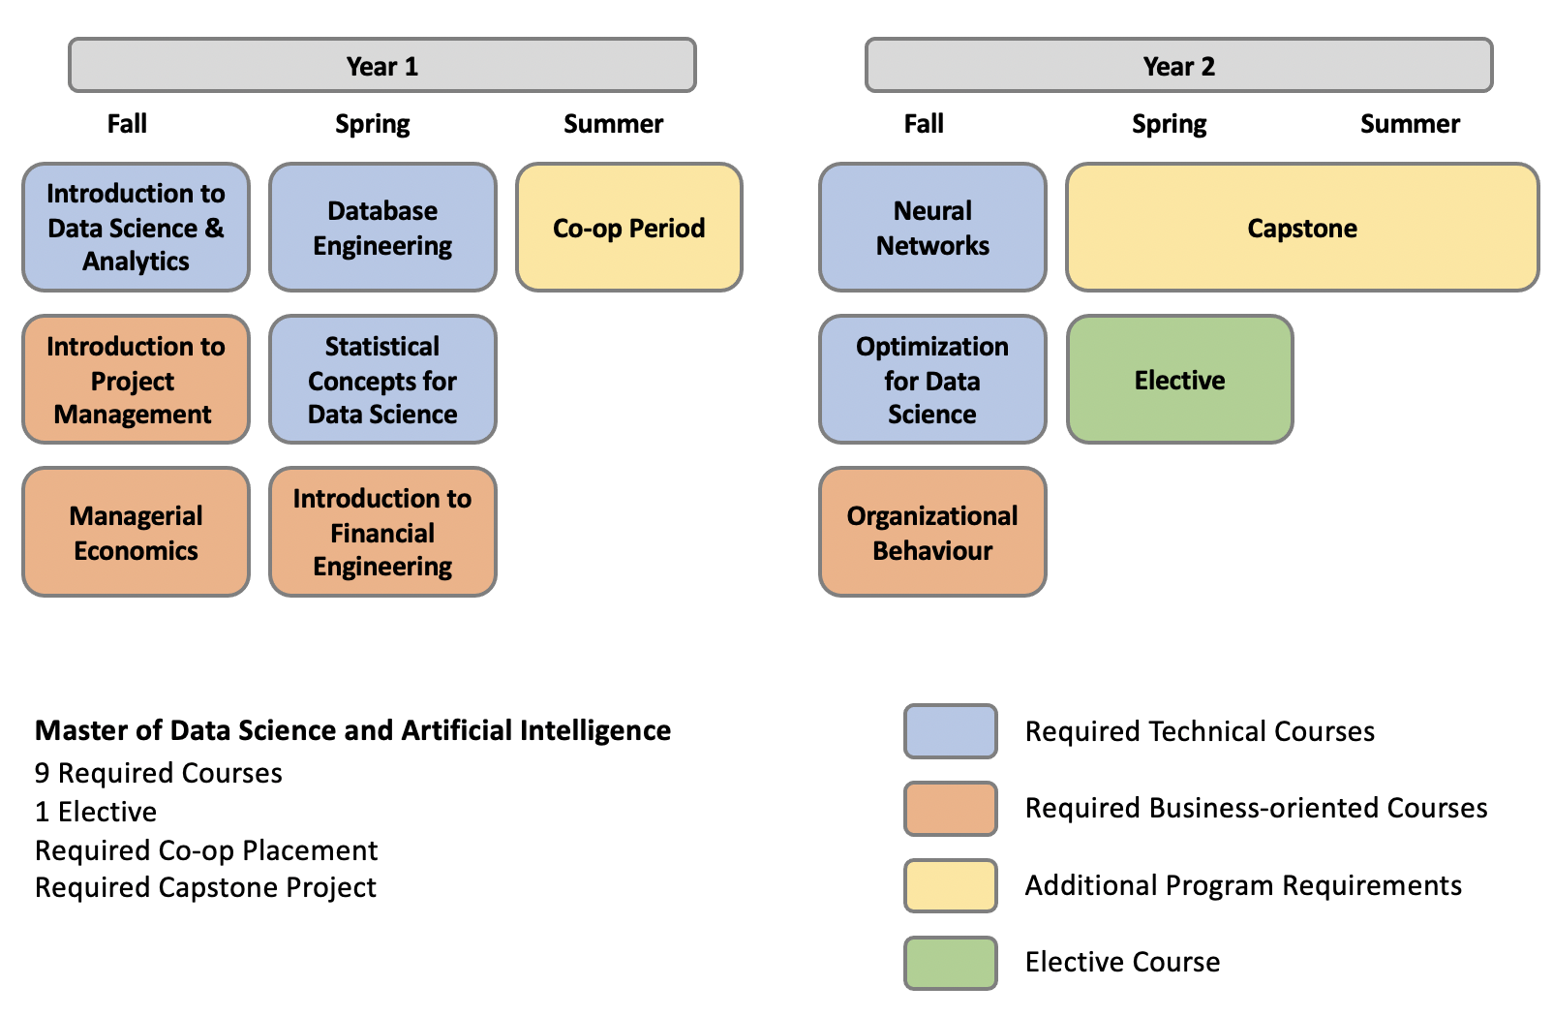
Program Structure Overview

Slide 9
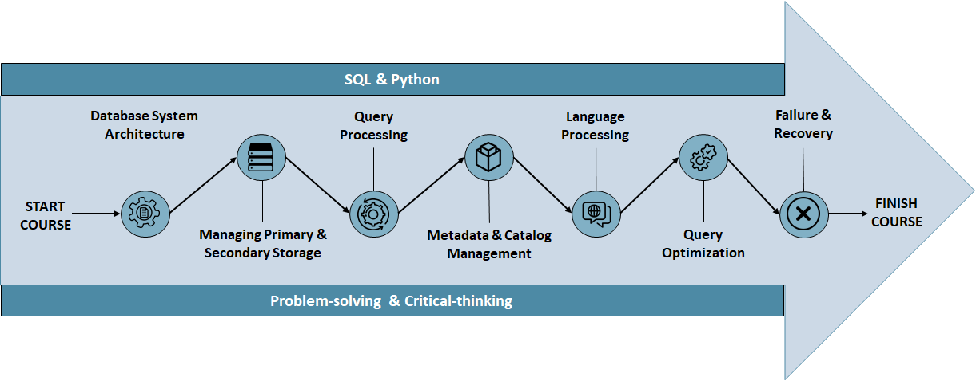
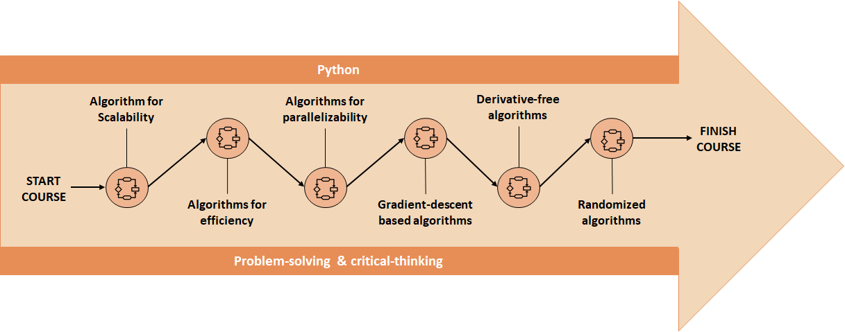
Courses Curriculum
Database Engineering
These are two examples of high-level course curriculums.
The core concepts of the course are displayed in the circles and the highlighted skills are indicated above and below the arrows.
Optimization for Data Science

Slide 10
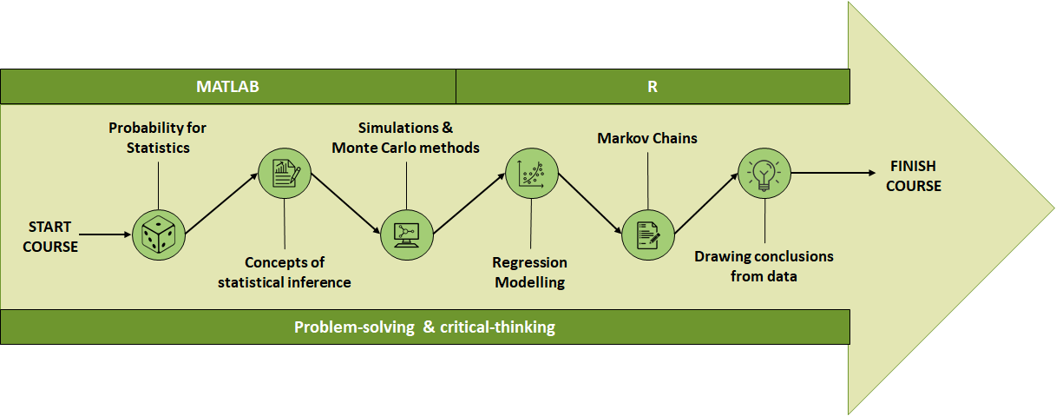
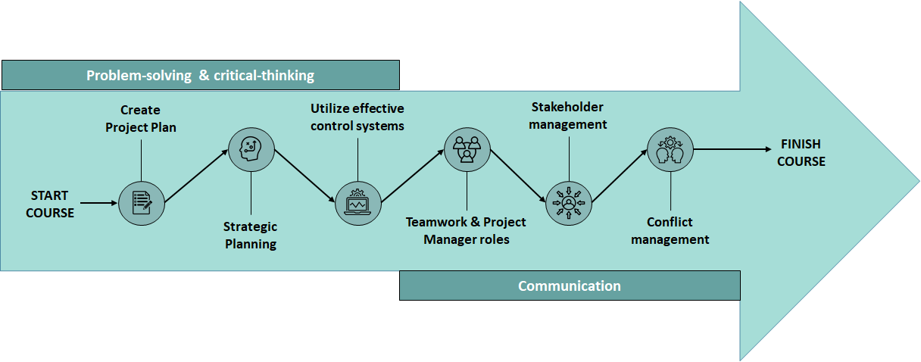
Courses Curriculum
Statistical Concepts for Data Science
These are another 2 examples of the core courses offered, with each displaying the skills that will be learned sequentially throughout the term.
Introduction to Project Management

Slide 11





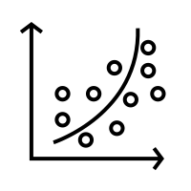
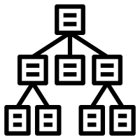

Detailed Curriculum Breakdown - MIE 1624
Tut 4 – Tableau Basic
Tut 5 – Power BI Basic
Tut 1 – Excel Basics
Tut 2 – R Basic
Tut 3 – SQL Application
Excel
R
SQL / Database
Power BI
Python
Tableau
Data Science Intro
Advanced
Machine Learning
Visualization
FINISH COURSE
START COURSE
Modelling and
Regression
Data Analytics Application
Business
Presentation
Problem-solving & Critical-thinking
Communication
Python basics
Basic Statistics
Data Cleaning
Assignment 1
Linear Regression
Logistic Regression
Python Visualization
Assignment 2
Decision Trees
KMeans Clustering
Neural Network and Deep Learning
Assignment 3
Optimization
Simulation
Forecasting
Report Writing
Presentation
Final Project -Real Business Problem

Slide 12




Proposed EdTech Solution
Collaborative Filtering
Identify relevant missing skills for the user
Shortlist courses related to missing skills
Generate profile stats and recommendation
We developed a personalised career coaching algorithm that attempts to solve the following problem:
“How to help working professionals/ students identify gaps in their knowledge base and upgrade their skills?”
User profile
Data from other profiles
Database of online courses and associated skills

Slide 13
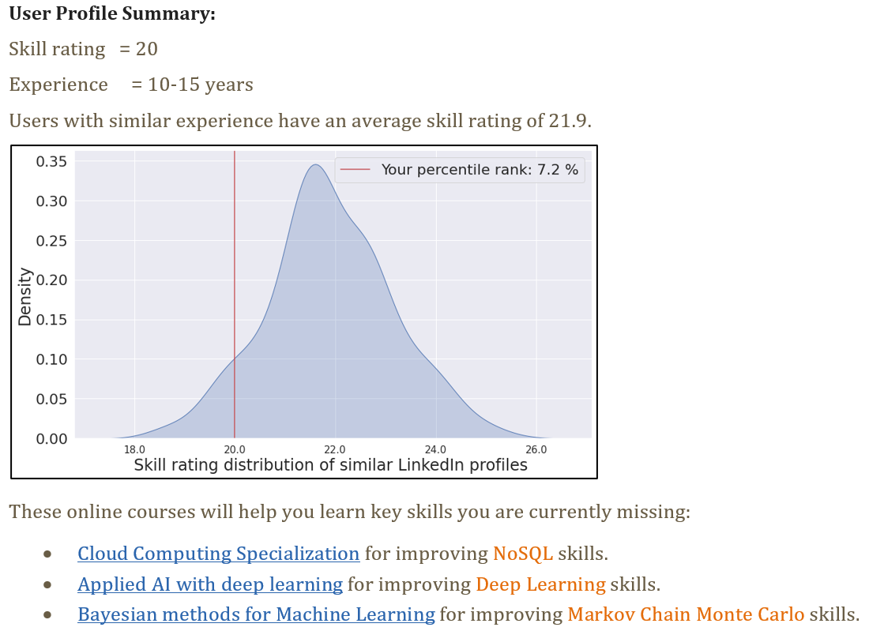
Personalised Career Coach
Let's look at some recommendations produced by the algorithm:
Index | Current Job | Previous Job | Experience (yrs) | Skills
User28 | Senior Data Scientist | Data Science Instructor | 10.58 | SQL, Data Analysis, Machine learning, +16 more

Slide 14
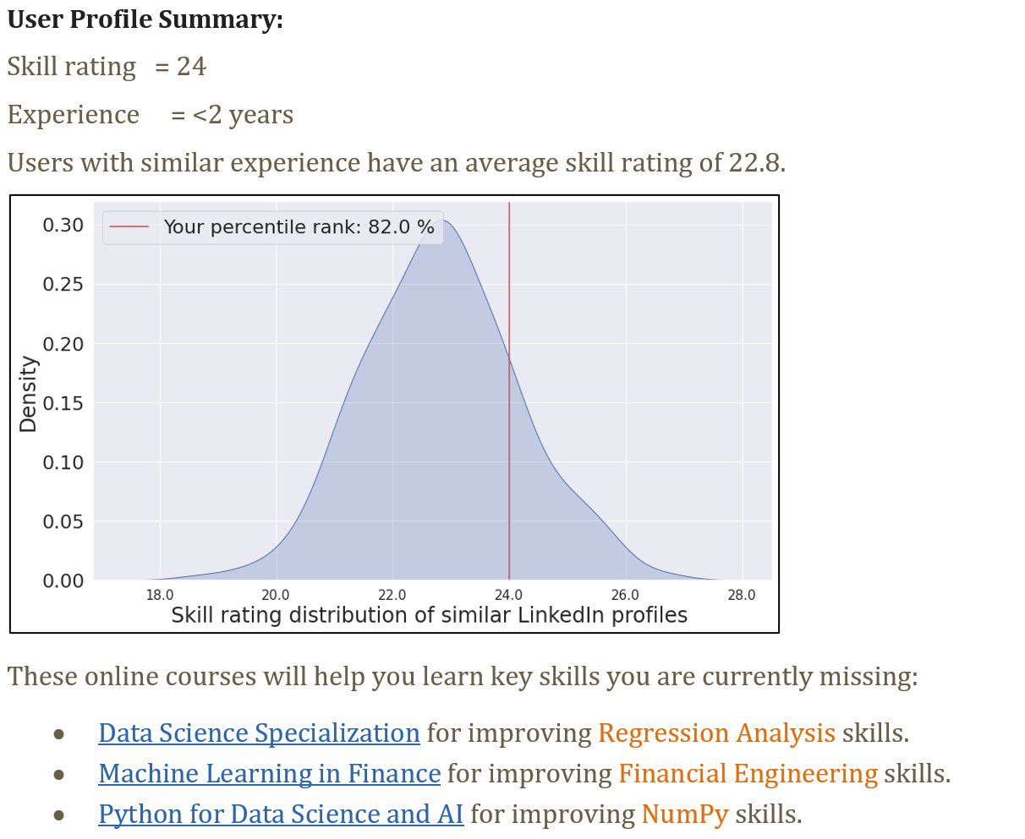
Personalised Career Coach
Index | Current Job | Previous Job | Experience (yrs) | Skills
User52 | Data Scientist | Senior Analyst | 1.83 | Statistics, R, Python, Visual Studio, SPSS, SQL,+18 more

Slide 15

Thank you

